Slide 1
Requirement Gathering and Analysis
UNIT -II

Slide 2
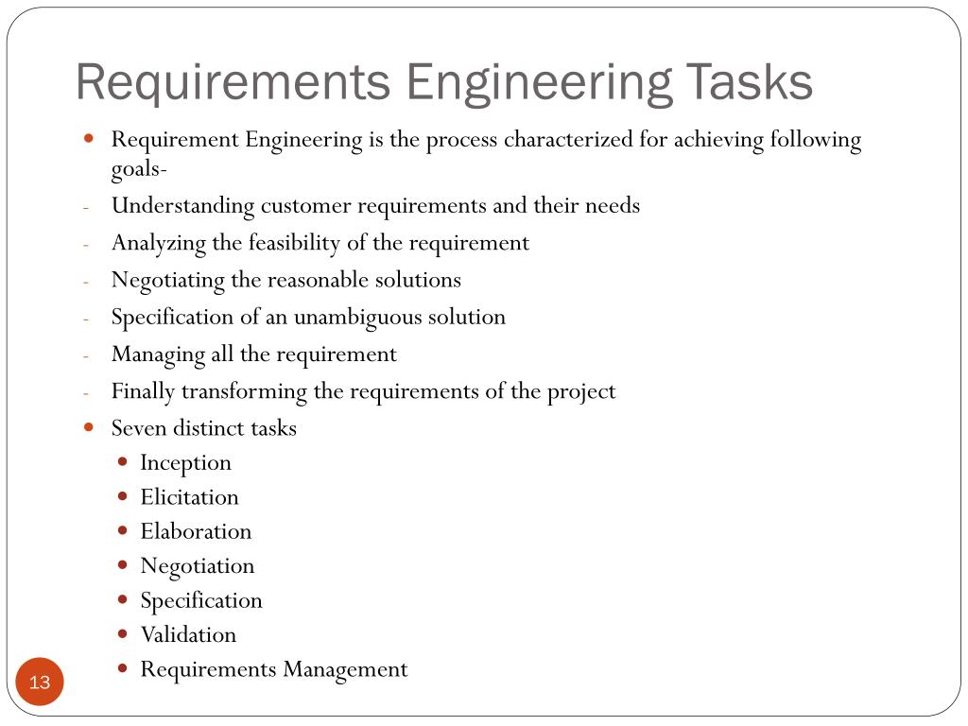

Slide 4
Elicitation
This is the second phase of the requirements analysis process. This phase focuses on gathering the requirements from the stakeholders.
One should be careful in this phase, as the requirements are what establishes the key purpose of a project.
Understanding the kind of requirements needed from the customer is very crucial for a developer

Slide 5
COTND…

Slide 7
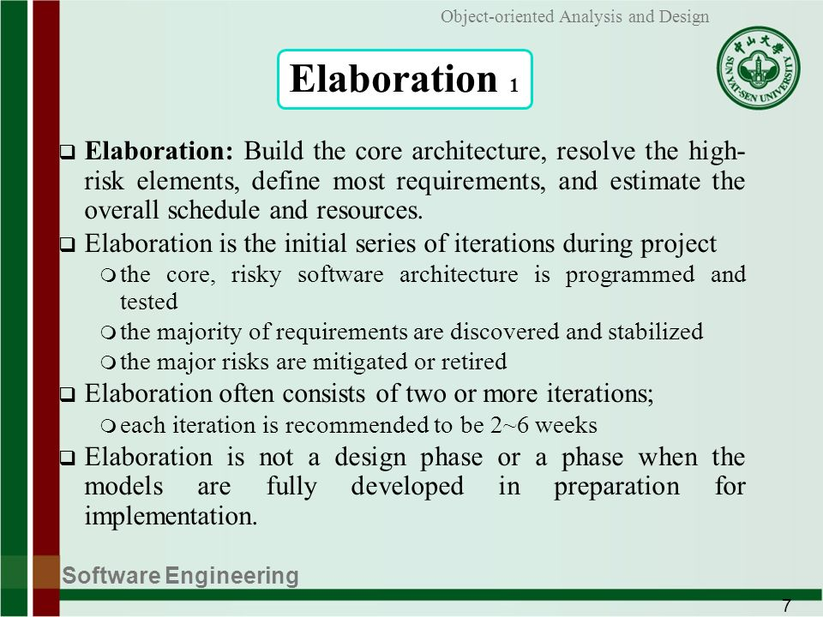

Slide 8
Negotiation
This phase emphasizes discussion and exchanging conversation on what is needed and what is to be eliminated.
In the negotiation phase, negotiation is between the developer and the customer and they dwell on how to go about the project with limited business resources.
The following are discussed in the negotiation phase:
Availability of Resources.
Delivery Time.
Scope of requirements.
Project Cost.
Estimations on development.

Slide 9
Specification
In the specification phase, the requirements engineer gathers all the requirements and develops a working model.
This final working product will be the basis of any functions, features or constraints to be observed.
This phase specifies the following:
Written document.
A set of models.
A collection of use cases.
A prototype.

Slide 10
Validation
This phase focuses on checking for errors and debugging. In the validation phase, the developer scans the specification document and checks for the following:
All the requirements have been stated and met correctly
Errors have been debugged and corrected.
Work product is built according to the standards.
This requirements validation mechanism is known as the formal technical review. The review team that works together and validates the requirements include software engineers, customers, users, and other stakeholders.
Everyone in this team takes part in checking the specification by examining for any errors, missing information, or anything that has to be added or checking for any unrealistic and problematic errors.

Slide 12
Eliciting Requirements
It perhaps the most difficult, most error-prone and most communication intensive software development. It can be successful only through an effective customer-developer partnership.
Collaborative Requirements Gathering
Meeting are conducted and attended by both software engineers and customers
Rules for preparation and participation are established
An agenda is suggested that is formal enough to cover all important points but informal enough to encourage the free flow of ideas
A facilitator controls the meeting.
The goal is to identify the problem,propose elements of solution,negotiate different approaches and specify a preliminary set of solution

Slide 13
Quality Function Deployment:
In this technique customer satisfaction is of prime concern, hence it emphasizes on the requirements which are valuable to the customer. 3 types of requirements are identified –
Normal requirements – In this the objective and goals of the proposed software are discussed with the customer. Example – normal requirements for a result management system may be entry of marks, calculation of results etc
Expected requirements – These requirements are so obvious that the customer need not explicitly state them. Example – protection from unauthorised access.
Exciting requirements – It includes features that are beyond customer’s expectations and prove to be very satisfying when present. Example – when an unauthorised access is detected, it should backup and shutdown all processes.

Slide 14
The major steps involved in this procedure are –
Identify all the stakeholders, eg. Users, developers, customers etc
List out all requirements from customer.
A value indicating degree of importance is assigned to each requirement.
In the end the final list of requirements is categorised as –
It is possible to achieve
It should be deferred and the reason for it
It is impossible to achieve and should be dropped off

Slide 15
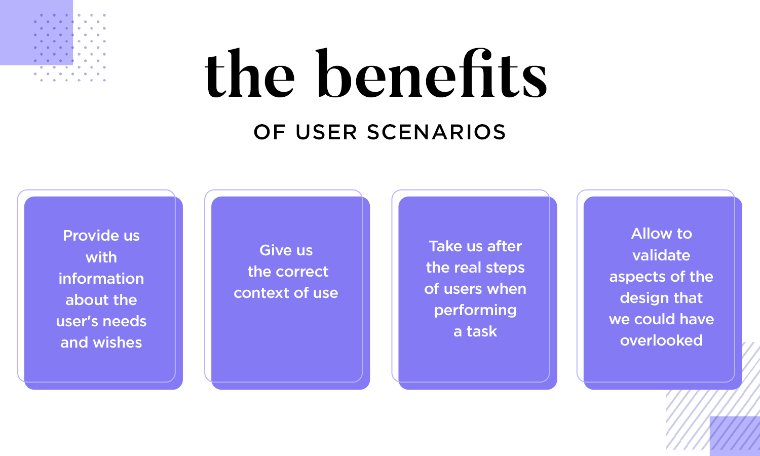

Slide 16
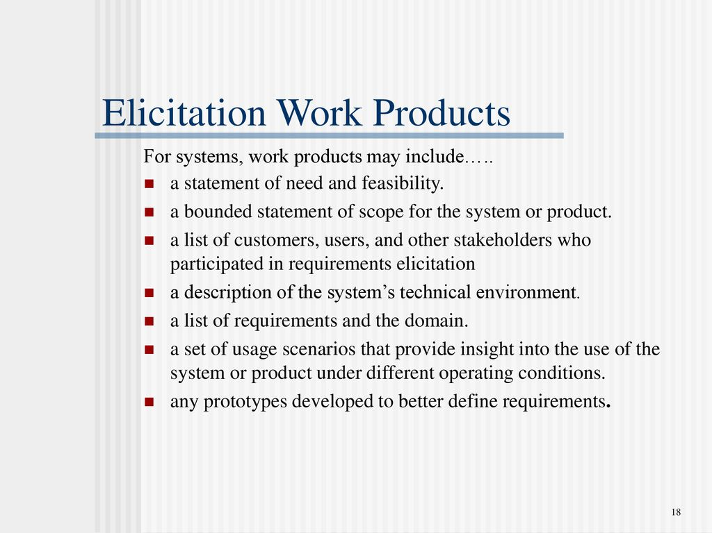

Slide 17
Use Case Approach:
This technique combines text and pictures to provide a better understanding of the requirements.
The use cases describe the ‘what’, of a system and not ‘how’. Hence they only give a functional view of the system.
The components of the use case deign includes three major things – Actor, Use cases, use case diagram.
Actor – It is the external agent that lies outside the system but interacts with it in some way. An actor maybe a person, machine etc. It is represented as a stick figure. Actors can be primary actors or secondary actors.
Primary actors – It requires assistance from the system to achieve a goal.
Secondary actor – It is an actor from which the system needs assistance.

Slide 18
Use cases – They describe the sequence of interactions between actors and the system. They capture who(actors) do what(interaction) with the system. A complete set of use cases specifies all possible ways to use the system.
Use case diagram – A use case diagram graphically represents what happens when an actor interacts with a system. It captures the functional aspect of the system.
A stick figure is used to represent an actor.
An oval is used to represent a use case.
A line is used to represent a relationship between an actor and a use case.
Four actors can be defined: Programmer,tester,monitor and troubleshooter

Slide 19
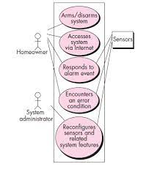

Slide 20
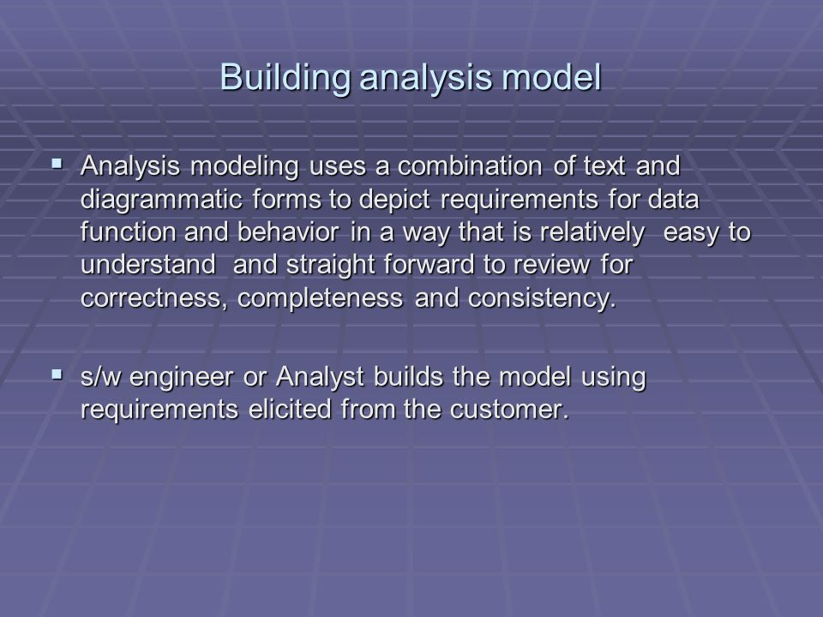

Slide 21
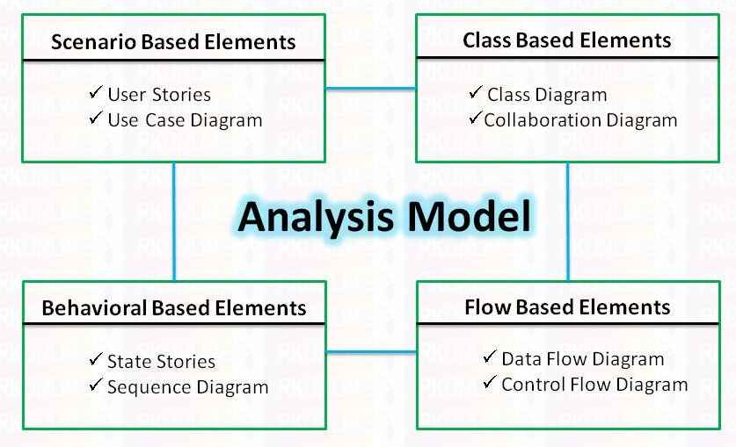

Slide 22
Building the Analysis Model
Elements of the analysis model
Scenario-based elements
Functional—processing narratives for software functions
Use-case—descriptions of the interaction between an “actor” and the system
Class-based elements
Implied by scenarios
Behavioral elements
State diagram – implementation approach
Flow-oriented elements
Data flow diagram
Analysis Patterns
Suggest solutions (class, function, behavior) within the application domain that can be reused when modelling many applications

Slide 23
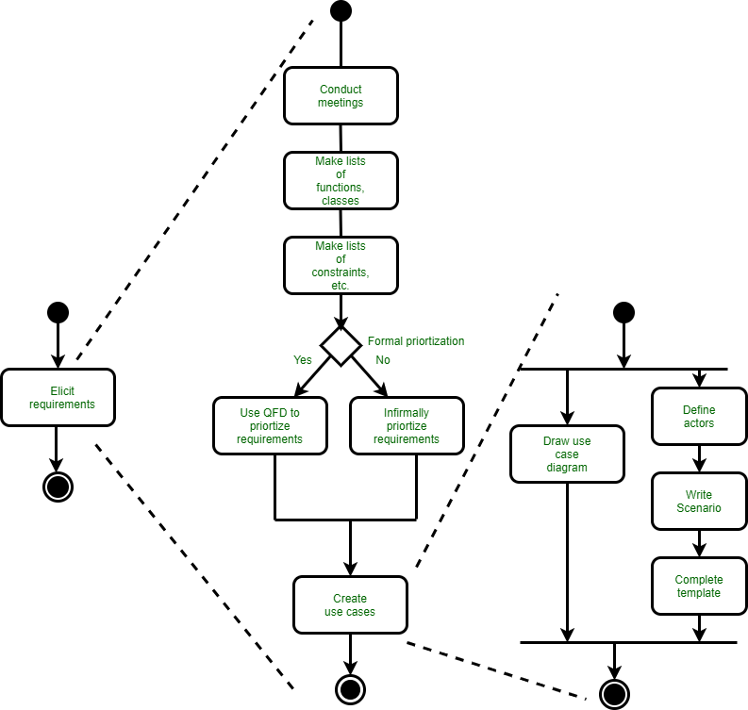
Eliciting Requirements

Slide 24
Class Diagram
From the SafeHome system …

Slide 25
State Diagram
Reading
Commands
State name
System status = “ready”
Display msg = “enter cmd”
Display status = steady
State variables
Entry/subsystems ready
Do: poll user input panel
Do: read user input
Do: interpret user input
State activities

Slide 26
Analysis Patterns
Pattern name: A descriptor that captures the essence of the pattern.
Intent: Describes what the pattern accomplishes or represents
Motivation: A scenario that illustrates how the pattern can be used to address the problem.
Forces and context: A description of external issues (forces) that can affect how the pattern is used and also the external issues that will be resolved when the pattern is applied.
Solution: A description of how the pattern is applied to solve the problem with an emphasis on structural and behavioral issues.
Consequences: Addresses what happens when the pattern is applied and what trade-offs exist during its application.
Design: Discusses how the analysis pattern can be achieved through the use of known design patterns.
Known uses: Examples of uses within actual systems.
Related patterns: On e or more analysis patterns that are related to the named pattern because (1) it is commonly used with the named pattern; (2) it is structurally similar to the named pattern; (3) it is a variation of the named pattern.

Slide 27
Negotiating Requirements
Identify the key stakeholders
These are the people who will be involved in the negotiation
Determine each of the stakeholders “win conditions”
Win conditions are not always obvious
Negotiate
Work toward a set of requirements that lead to “win-win”

Slide 28
Requirements Monitoring
Especially needed in incremental development
Distributed debugging – uncovers errors and determines their cause.
Run-time verification – determines whether software matches its specification.
Run-time validation – assesses whether evolving software meets user goals.
Business activity monitoring – evaluates whether a system satisfies business goals.
Evolution and codesign – provides information to stakeholders as the system evolves.

Slide 29
Validating Requirements - I
Is each requirement consistent with the overall objective for the system/product?
Have all requirements been specified at the proper level of abstraction? That is, do some requirements provide a level of technical detail that is inappropriate at this stage?
Is the requirement really necessary or does it represent an add-on feature that may not be essential to the objective of the system?
Is each requirement bounded and unambiguous?
Does each requirement have attribution? That is, is a source (generally, a specific individual) noted for each requirement?
Do any requirements conflict with other requirements?

Slide 30
Validating Requirements - II
Is each requirement achievable in the technical environment that will house the system or product?
Is each requirement testable, once implemented?
Does the requirements model properly reflect the information, function and behavior of the system to be built.
Has the requirements model been “partitioned” in a way that exposes progressively more detailed information about the system.
Have requirements patterns been used to simplify the requirements model. Have all patterns been properly validated? Are all patterns consistent with customer requirements?

Slide 31
Requirements Analysis
Requirements analysis
specifies software’s operational characteristics
indicates software's interface with other system elements
establishes constraints that software must meet
Requirements analysis allows the software engineer (called an analyst or modeler in this role) to:
elaborate on basic requirements established during earlier requirement engineering tasks
build models that depict user scenarios, functional activities, problem classes and their relationships, system and class behavior, and the flow of data as it is transformed.

Slide 32
A Bridge

Slide 33
Rules of Thumb
The model should focus on requirements that are visible within the problem or business domain. The level of abstraction should be relatively high.
Each element of the analysis model should add to an overall understanding of software requirements and provide insight into the information domain, function and behavior of the system.
Delay consideration of infrastructure and other non-functional models until design.
Minimize coupling throughout the system.
Be certain that the analysis model provides value to all stakeholders.
Keep the model as simple as it can be.

Slide 34
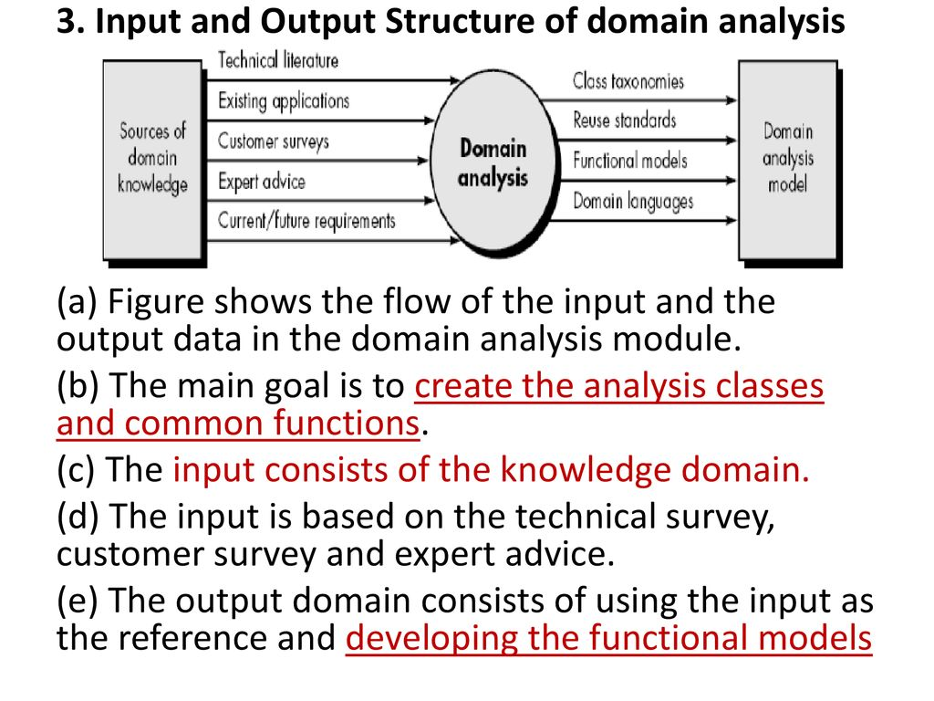
Domain Analysis

